Slide 1

Introduction to URDF

Slide 2
Unified Robot Description Format
URDF describes a robot as a tree of links, that are connected by joints. The links represent the physical components of the robot, and the joints represent how one link moves relative to another link, effectively defining the location of the links in space.
When we write our URDF file we need to figure out how to split the robot up sensibly into links (and joints). There are two main reasons we would designate a link/joint:
A part of the robot is moving relative to another part (e.g. each segment of a robotic arm)
A part that is not moving relative to another part, but it is convenient to have its own reference point and transform (a common example would be the location of a sensor such as a camera or lidar)

Slide 3
To cover these scenarios, when we define a joint (the connection between two links) we need to choose what type of joint it is. There are quite a few types, but the most common are:
Revolute - A rotational motion, with minimum/maximum angle limits.
Continuous - A rotational motion with no limit (e.g. a wheel).
Prismatic - A linear sliding motion, with minimum/maximum position limits.
Fixed - The child link is rigidly connected to the parent link. This is what we use for those "convenience" links.

Slide 4
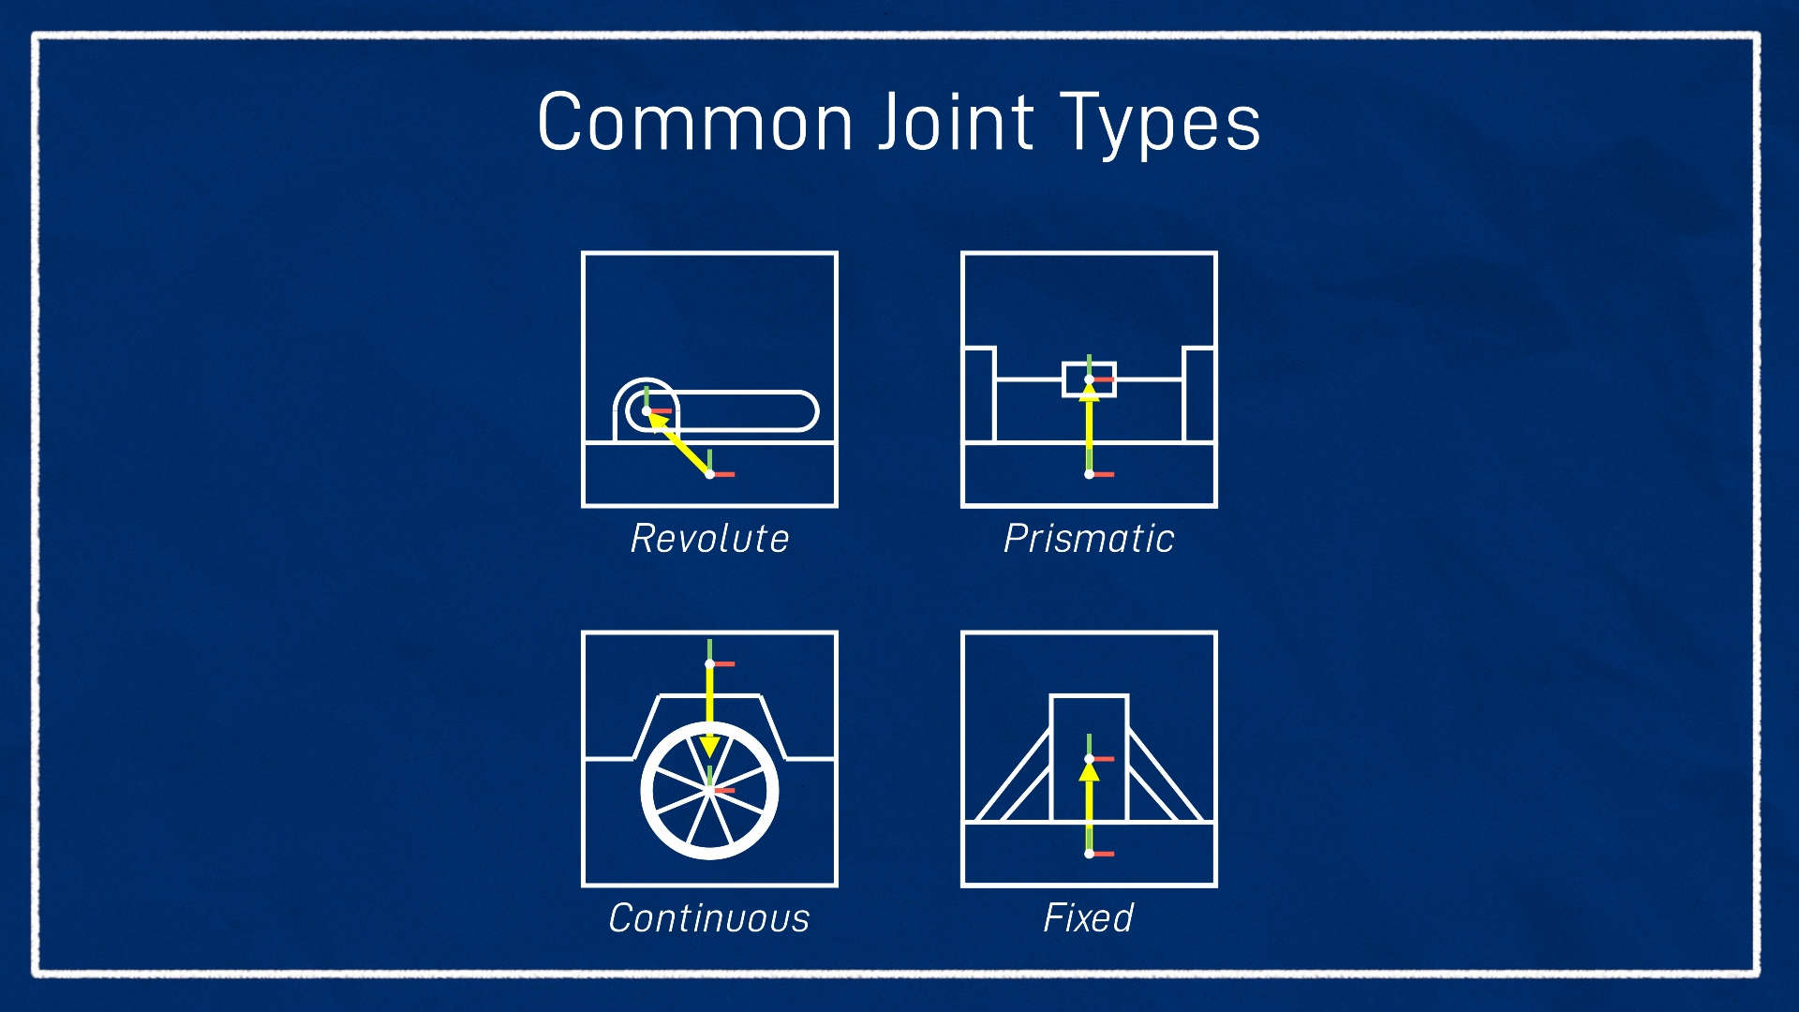

Slide 5
The URDF Syntax
URDF is based on XML, so everything is represented as a series of tags, which can be nested. There are many different tags we can use, but there are three main ones we need to know about.
The robot tag and XML declaration
A proper XML file should have an XML declaration/prolog in the first line, and then after that will be a single tag (called the root tag), which ALL the other tags live inside of. For a URDF file, this root tag will be the robot tag, and the only thing to note here for now is that we can set the name attribute which lets us (unsurprisingly) specify the name of our robot.
<?xml version="1.0"?>
<robot name="my_robot">
...
all the rest of the tags
...
</robot>

Slide 6
A link tag lets us firstly specify the name of a link, as well as some additional characteristics - the visual, collision, and inertial properties. These additional tags are generally optional, however they will be required for certain situations such as simulations (which we'll cover in a later tutorial).
Visual - This is what we see in RViz and Gazebo. We can specify three aspects:
Geometry - box/ cylinder / sphere with size parameters, or a mesh
Origin - an offset for the geometry so it doesn't need to be centred around the link origin
Material - Basically, the colour. We can specify the name of a declared material, or describe the colour directly. (Note that this will set the colour in RViz but not Gazebo, more on that in the next tutorial)
Collision - This is used for physics collision calculations. We can set the:
Geometry and Origin - Same options as for visual. This will often be copy-pasted from the Visual tag, however we may want a simpler collision geometry (e.g. box instead of a mesh) for computational reasons.

Slide 7
Inertial - This is also used for physics calculations, but determines how the link responds to forces. The inertial properties are:
Mass - Mass of the link
Origin - The centre of mass (a.k.a centre of gravity). This is the point the link could "balance" on (a slightly more confusing concept in 3D). For most simple cases this will just be the centre (same origin as visual/collision).
Inertia - The rotational inertia matrix. This is probably the most confusing part of this section. It describes how the distribution of the mass will affect rotation. A list of the matrices for common shapes is available here. A fairly accurate simulation can be achieved by approximating our links as prisms, ellipsoids, or cylinders, however for most purposes a very rough guess will do. Also, don't get inertial and inertia mixed up - the inertia matrix is just one part of the inertial properties.

Slide 8
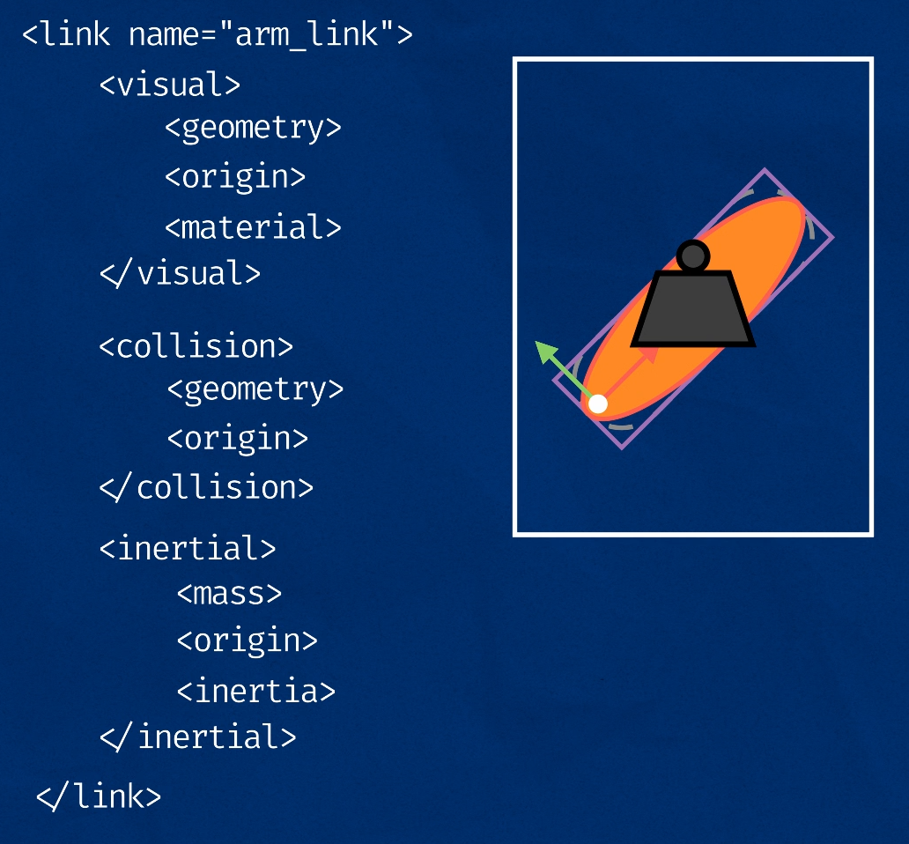

Slide 9
Although we usually think of the robot as being made up of links, the joints are actually where all the detail is in terms of the robot's structure, as they define the link locations, and how they move relative to each other. This is similar to the previous tutorial on the TF system, where although we ultimately want to interact with frames, it's actually the transforms that define where the frames are, so it's important to get them right.
Each joint will need to have the following specified:
Name - A name for the joint. If we don't have this, some things will still work, but other things won't. It's good to name them all just in case.
Type - The joint type as mentioned earlier (the four most popular being fixed, prismatic, revolute, and continuous).
Parent and child links - Which links this joint defines a relationship between
Origin - The relationship between the two links, before any motion is applied
For a fixed joint these parameters will be sufficient, but for non-fixed joints we will usually want to specify some other characteristics. There are a few to choose from, but the two most common will be:
Axis - Which axis to move along or around
Limits - Physical actuation limits, which may be expected by other parts of the system. These can include:
Upper and Lower position limits - in metres/radians
Velocity limits - in m/s or rad/s
Effort limits - in N or Nm

Slide 10
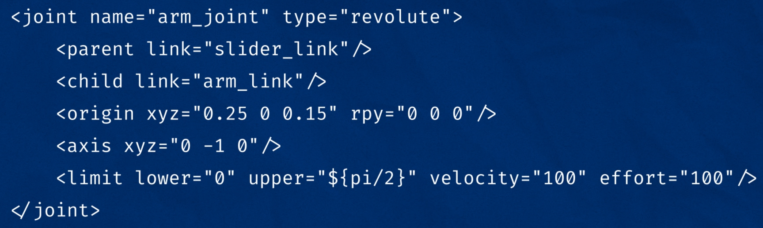

Slide 11
URDF is an XML format used to describe the physical properties and structure of a robot. It provides a way to define:
Links: Rigid bodies that make up the robot.
Joints: Connections between links that allow movement.
Visual Elements: Meshes or shapes that represent the robot visually.
Collision Models: Simplified shapes used for collision detection.
Transmission: Mechanisms that connect joints and actuators.

Slide 12
Eg:
<robot name="my_robot">
<link name="base_link">
<visual>
<geometry>
<box size="1 1 0.1"/>
</geometry>
</visual>
</link>

Slide 13
Eg:cont..
<joint name="base_to_link1" type="fixed">
<parent link="base_link"/>
<child link="link1"/>
</joint>
<link name="link1">
<visual>
<geometry>
<cylinder radius="0.1" length="1.0"/>
</geometry>
</visual>
</link>
</robot>

Slide 14
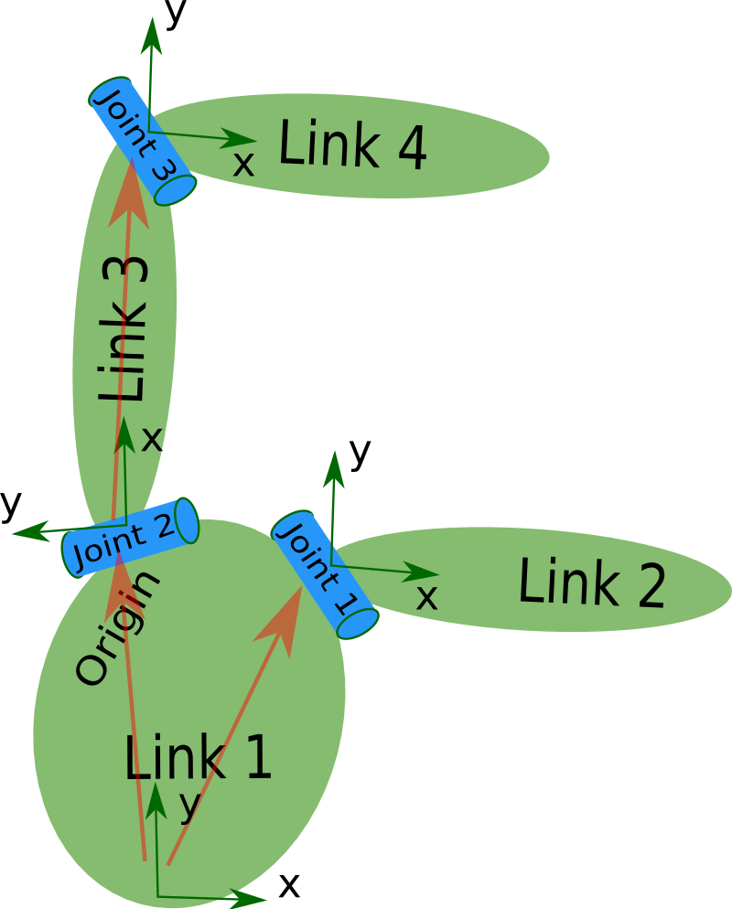

Slide 15
<robot name="test_robot">
<link name="link1" />
<link name="link2" />
<link name="link3" />
<link name="link4" />
<joint name="joint1" type="continuous">
<parent link="link1"/>
<child link="link2"/>
</joint>
<joint name="joint2" type="continuous">
<parent link="link1"/>
<child link="link3"/>
</joint>
<joint name="joint3" type="continuous">
<parent link="link3"/>
<child link="link4"/>
</joint>
</robot>

Slide 16
XML Specifications
robot
Describes all properties of a robot.
sensor/proposals
Describes a sensor, such as a camera, ray sensor, etc
link
Describes the kinematic and dynamic properties of a link.
transmission
Transmissions link actuators to joints and represents their mechanical coupling
joint
Describes the kinematic and dynamic properties of a joint.
gazeboDescribes simulation properties, such as damping, friction, etc
sensor
Describes a sensor, such as a camera, ray sensor, etc
model_state
Describes the state of a model at a certain time
model
Describes the kinematic and dynamic properties of a robot structure.

Slide 17
Simple URDF
<?xml version="1.0"?>
<robot name="simple_robot">
<!-- Base link -->
<link name="base_link">
<visual>
<geometry>
<box size="0.2 0.2 0.1" />
</geometry>
<material name="gray">
<color rgba="0.5 0.5 0.5 1" />
</material>
</visual>
</link>

Slide 18
Simple URDF cont…
<!-- Arm link -->
<link name="arm_link">
<visual>
<geometry>
<cylinder radius="0.05" length="0.5" />
</geometry>
<material name="blue">
<color rgba="0 0 1 1" />
</material>
</visual>
</link>

Slide 19
Simple URDF cont…
<!-- Joint connecting the base and the arm -->
<joint name="base_to_arm" type="revolute">
<parent link="base_link" />
<child link="arm_link" />
<origin xyz="0 0 0.05" rpy="0 0 0" />
<axis xyz="0 0 1" />
<limit lower="0" upper="1.57" effort="10" velocity="1" />
</joint>
</robot>

